Slide 1
RPM & YUM

Slide 2
Full Form
RPM-Redhat Package Manager.
YUM-Yellowdog Updater Modified.

Slide 3
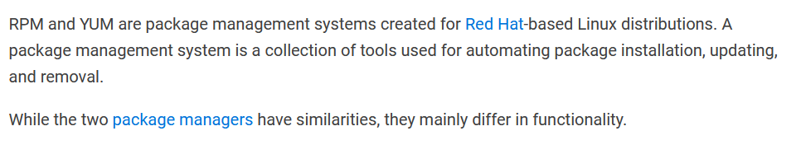
INTRODUCTION

Slide 4
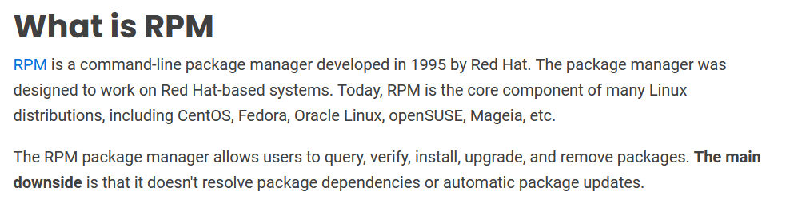
INTRODUCTION

Slide 5
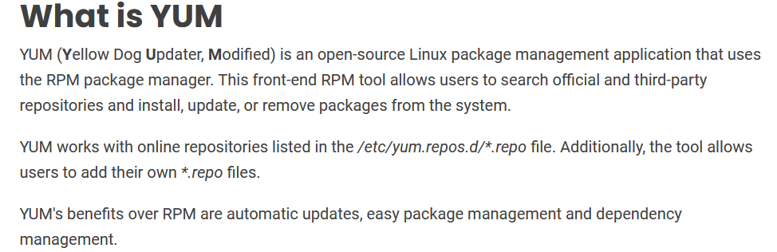
INTRODUCTION

Slide 6
INTRODUCTION
On RedHat, CentOS, and Fedora, the RMP package manager, or RedHat package manager is the software that builds, installs, updates, and otherwise manages individual software packages on a system.
These packages contain either pre-compiled binary files, or source code to build binaries, and metadata that describes how RPM should treat the files, where they should be installed in the system, how they should be compiled, and so on.
We can either use RPM directly, if we have a .rpm file to install, or we can use yum to search respositories and interact with RPM.
Yum stands for Yellowdog Updater, Modified. The name Yellowdog comes from a distribution of Linux that was focused on IBM's power line of processors.

Slide 7
Yum, sitting on top of RPM, is the default package management interface on RedHat Enterprise Linux, CentOS, and older versions of Fedora.
As of Fedora 22, yum was switched out in favor of dandified yum, or DNF, which operates largely the same, though it can be faster, and has a different method of resolving package dependencies. DNF generally follows the same command syntax as yum.
One of the advantages we get from using yum, instead of just using RPM, is that yum manages dependencies for packages automatically.
So, if a given package requires, say, Perl or Python to run, yum will go out and grab that package and anything it might need to ensure the actual package we want to install has all of the resources and other packages that it expects. If you were to try to install a package that had dependencies with RMP, you'd need to know what all those dependencies are, and have all the RMP files for those dependencies already on hand. So yum saves us a lot of work.

Slide 8
yum gives us tools to work at a higher level, so we don't, for example, have to go search the web and download an RPM file to install. We can use tools yum provides to search for software and install it right from the command line.
RPM keeps track of software that's installed and removed in the RPM DB, and when you run certain yum commands, the yum software updates a local copy of the repo data, so you can find out information about packages when you're offline.

Slide 9
RPM maintains the database of installed software.
YUM maintains a local cache of repository data.

Slide 10
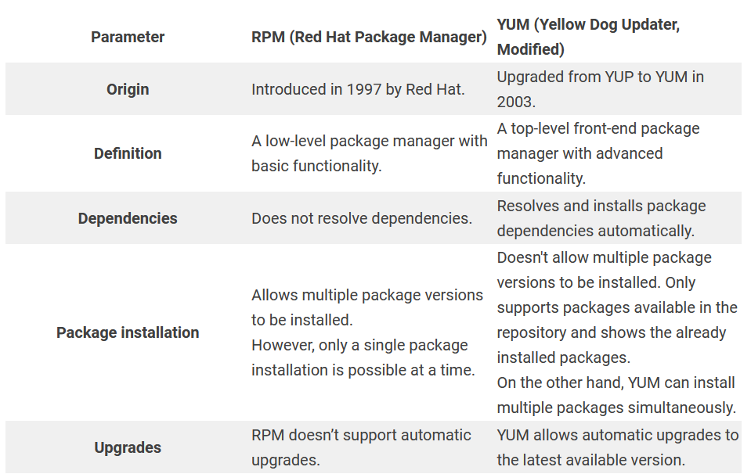
RPM vs YUM

Slide 11
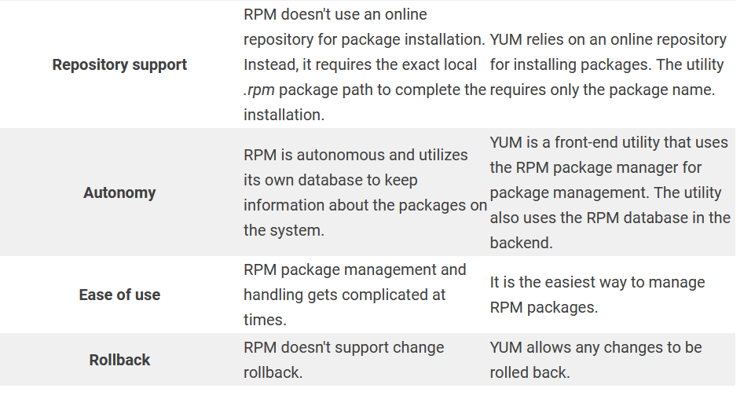

Slide 12
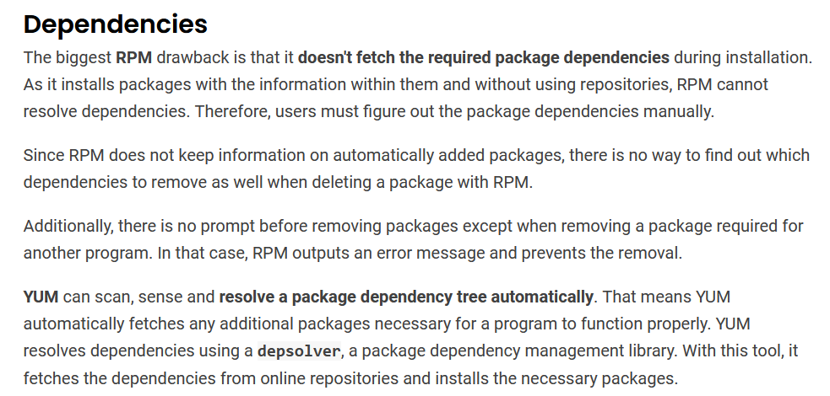

Slide 13
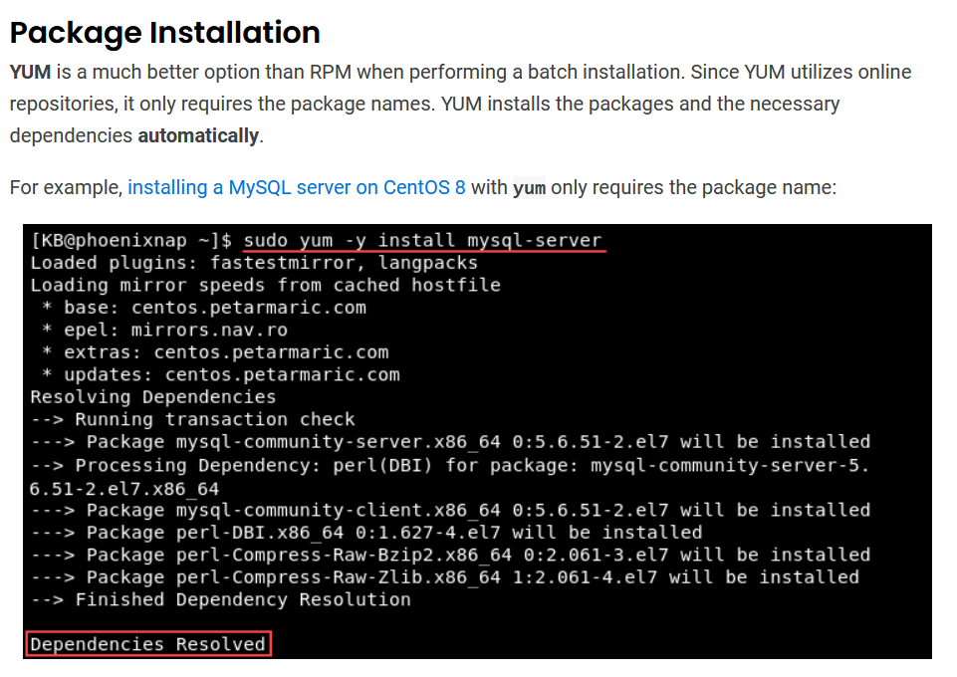

Slide 14
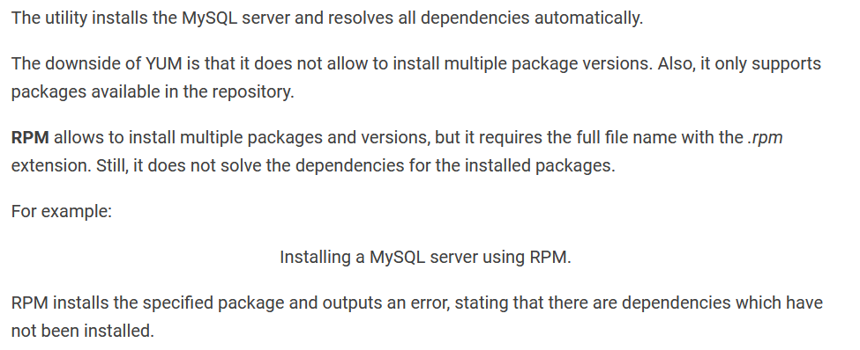

Slide 15
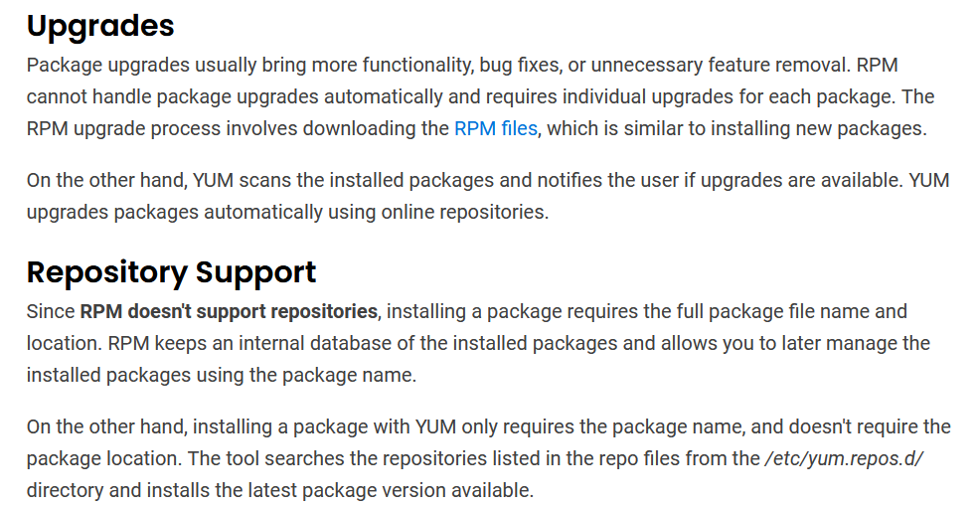

Slide 16
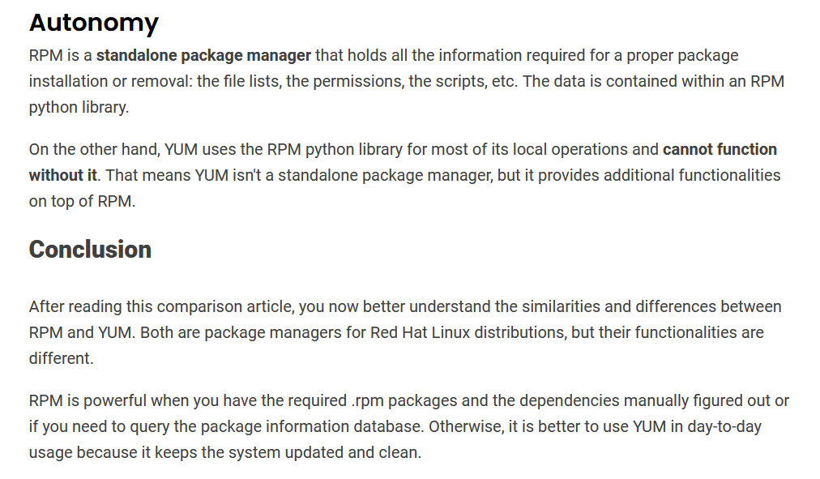

Slide 17
How to install RPM and YUM package
While working in Linux, you may have seen downloadable files with the .rpm extension. Rpm files are designed to be downloaded and installed independently, outside of a software repository.
RPM Package Manager (RPM) is a free and open-source package management system for installing, uninstalling and managing software packages in Linux.

Slide 18
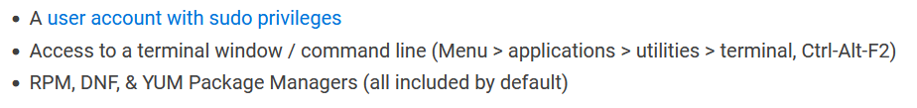
Prerequisites

Slide 19
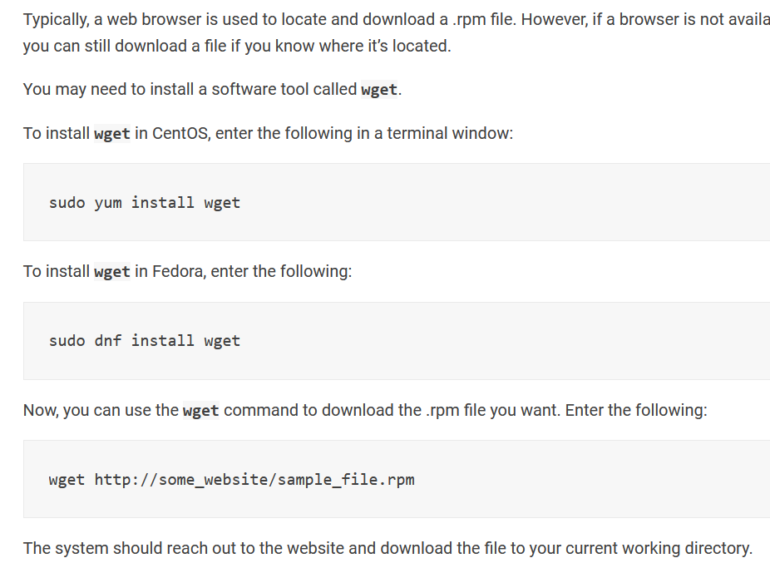
Download RPM Installation File
Wget is a networking command-line tool that lets you download files and interact with REST APIs. It supports the HTTP , HTTPS , FTP , and FTPS internet protocols. Wget can deal with unstable and slow network connections. In the event of a download failure, Wget keeps trying until the entire file has been retrieved.

Slide 20
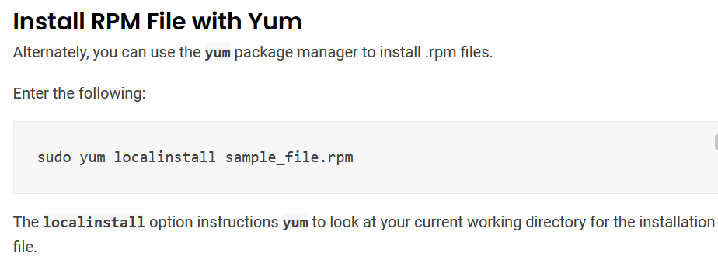
Install RPM File on Linux

Slide 21
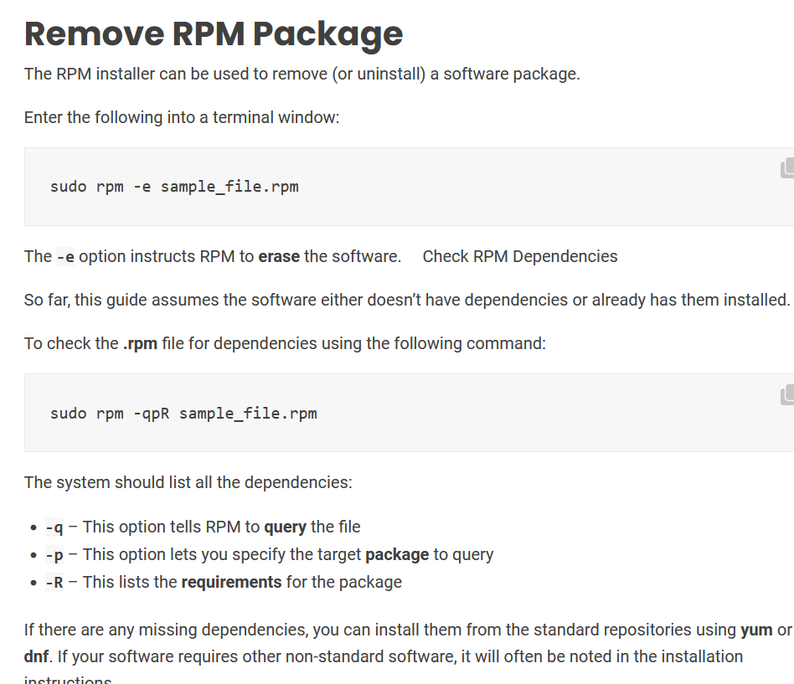

Slide 22
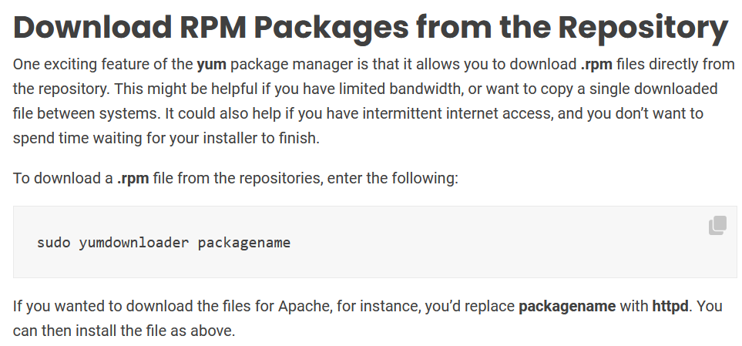

Slide 23
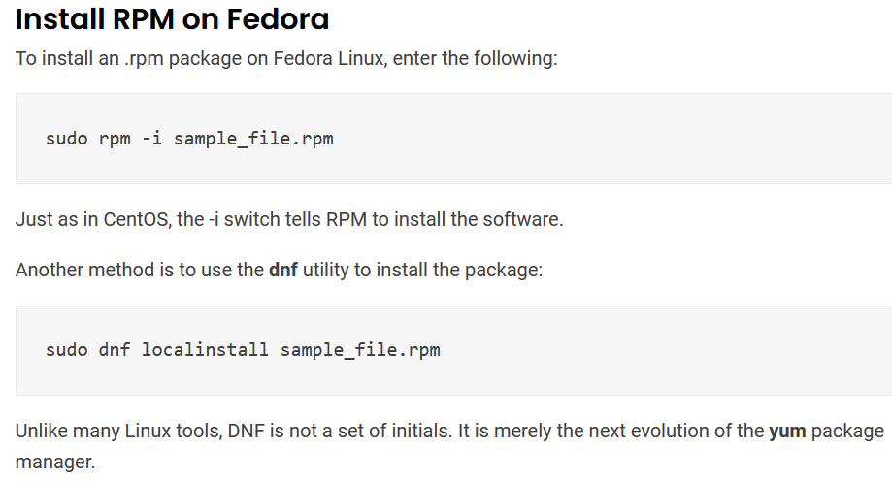

Slide 24
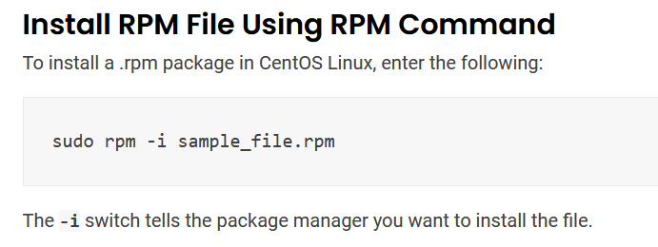
Install RPM File on Linux

Slide 25
Bibliography
https://phoenixnap.com/kb/rpm-vs-yum

